Slide 1
Car Analyzers & Recommenders
Lebe iwu, melaku wubshet, eric waxler

Slide 2
Wish List
What are the top car sales?
How many luxury car sales versus non luxury car sales by state?
What state is it more expensive to purchase a car?
Are cars cheaper in metropolitan areas as there are more options for public transportation and parking costs are higher?
If I want to buy a used luxury car how much would it cost me?
Are there more convertibles in California and Florida?
Are there more SUVs in the mountain states?

Slide 3
Data Sources
Kaggle - data of Used Car Sales
Each row represents one used car sale
Data from September 24 2017
Columns of data include:
ID – Car identification
Price – Car Price
Year - Car Year
Mileage – Car Mileage
City
State
VIN Number
Make – Car Manufacturer
Model – Car Model
GoogleMaps API
Used to create heatmap

Slide 4
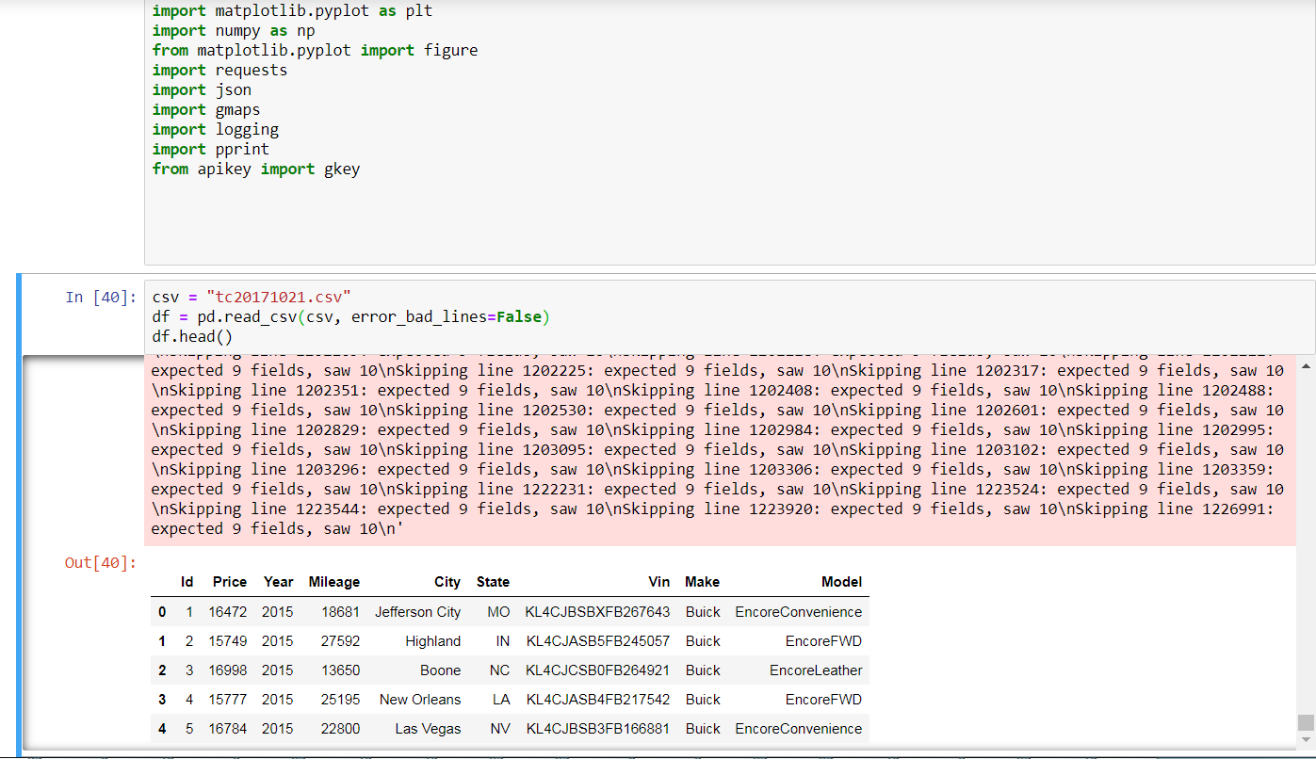
Jupyter Notebook

Slide 5
Data Cleansing
Data was downloaded
Str.strip() – used to strip characters from the beginning and end of the string
error_bad_lines – used to drop bad lines in our data
Str.upper() – used to make all our values for State uppercase
Dropna() – used to drop null values
str.title() – used to convert the first character of each word to uppercase and the remaining to lowercase

Slide 6
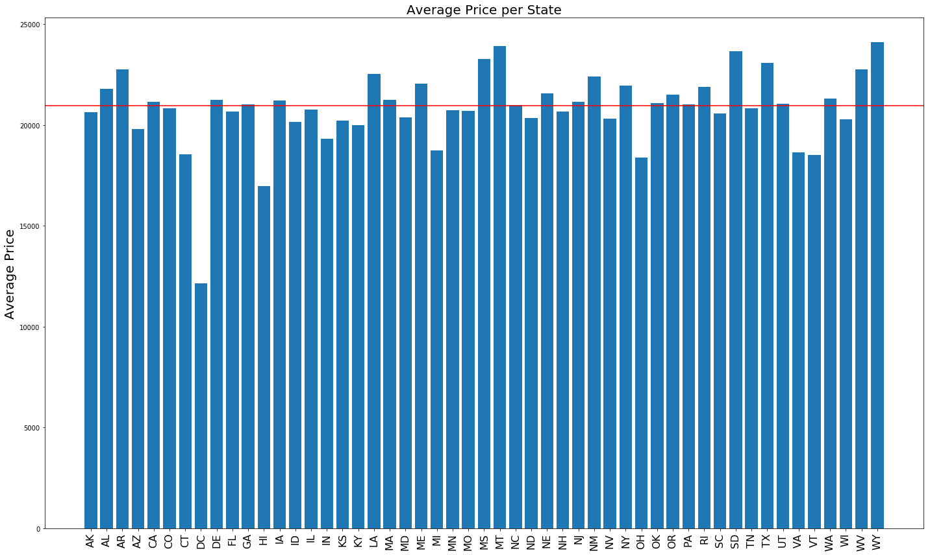
What is the average price of a used car in each state?

Slide 7
Luxury Vehicles Sales in Data Set
Mercedes-Benz
BMW
Lexus
Infiniti
Cadillac
Porsche
Jaguar
Maserati
Bentley
Audi
LandRover
Lotus
Acura
Ferrari
Aston
Genesis
Lamborghini
Rolls-Royce
Alfa
Maybach
McLaren
Volvo
AM
Tesla
Fisker

Slide 8
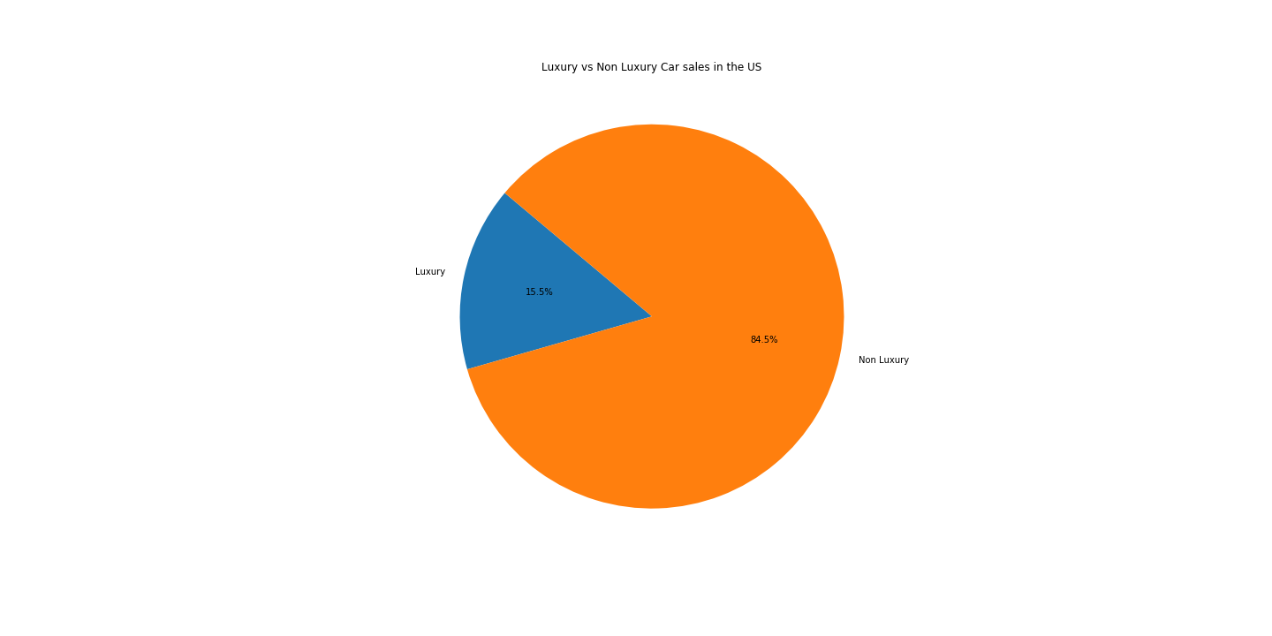
Luxury vs. Non-Luxury Car Sales
Notes:
84.5% of cars are non-luxury and 15.5% of cars are luxury

Slide 9
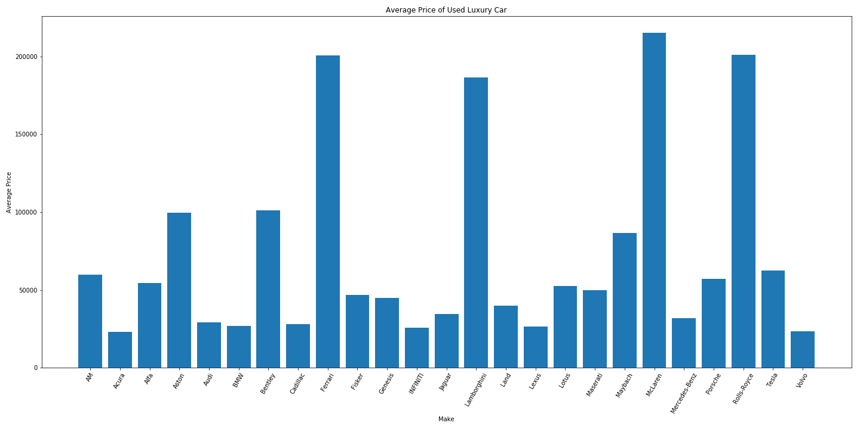
Average Price of Luxury Cars by Make
Notes:
McLaren - $215340.86, Rolls-Royce - $201293.83, Ferrari - $200600.09, Lamborghini, $186711.38

Slide 10
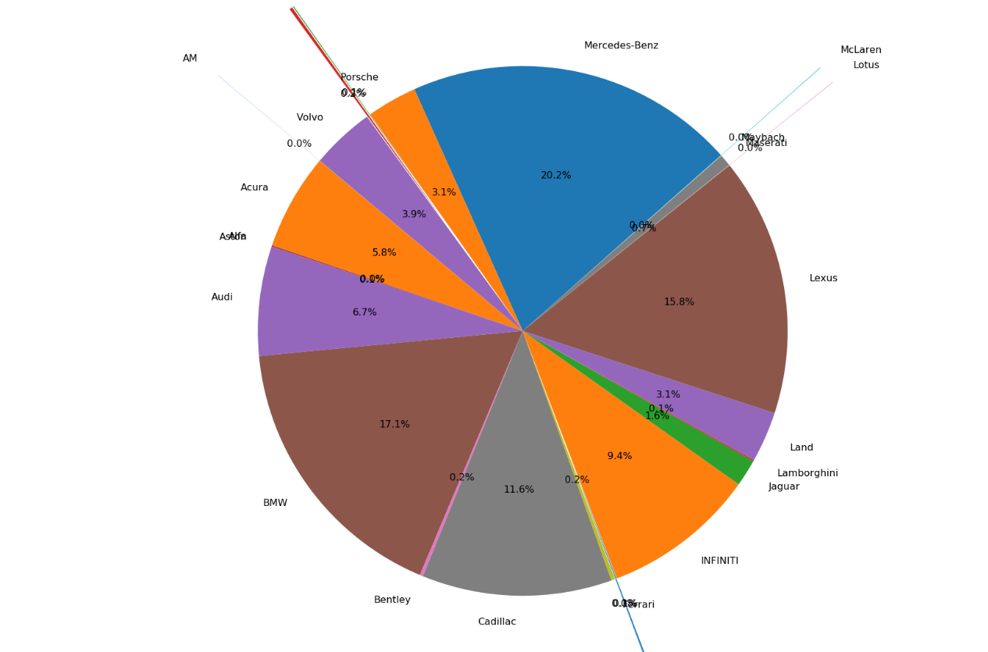
Which of the 25 luxury brands make up the top luxury car sales?

Slide 11
Luxury Car Sales Top 3
Mercedes Benz – 20.2%
BMW – 17.1%
Lexus – 15.8%
As a used car dealer, I want to know where I can get these cars the cheapest and what would be the average cost

Slide 12
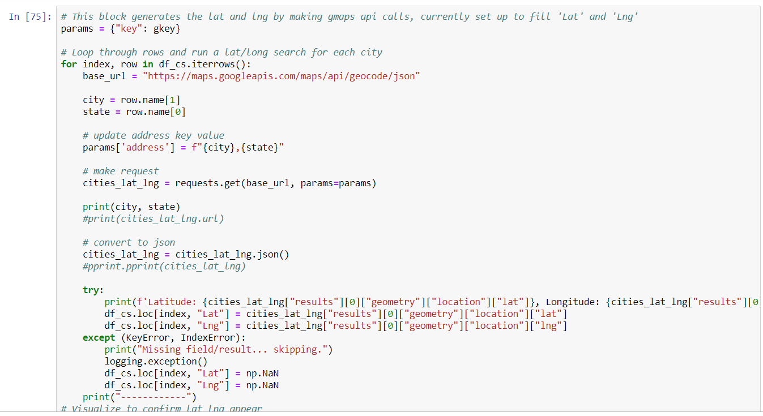
Heat map

Slide 13
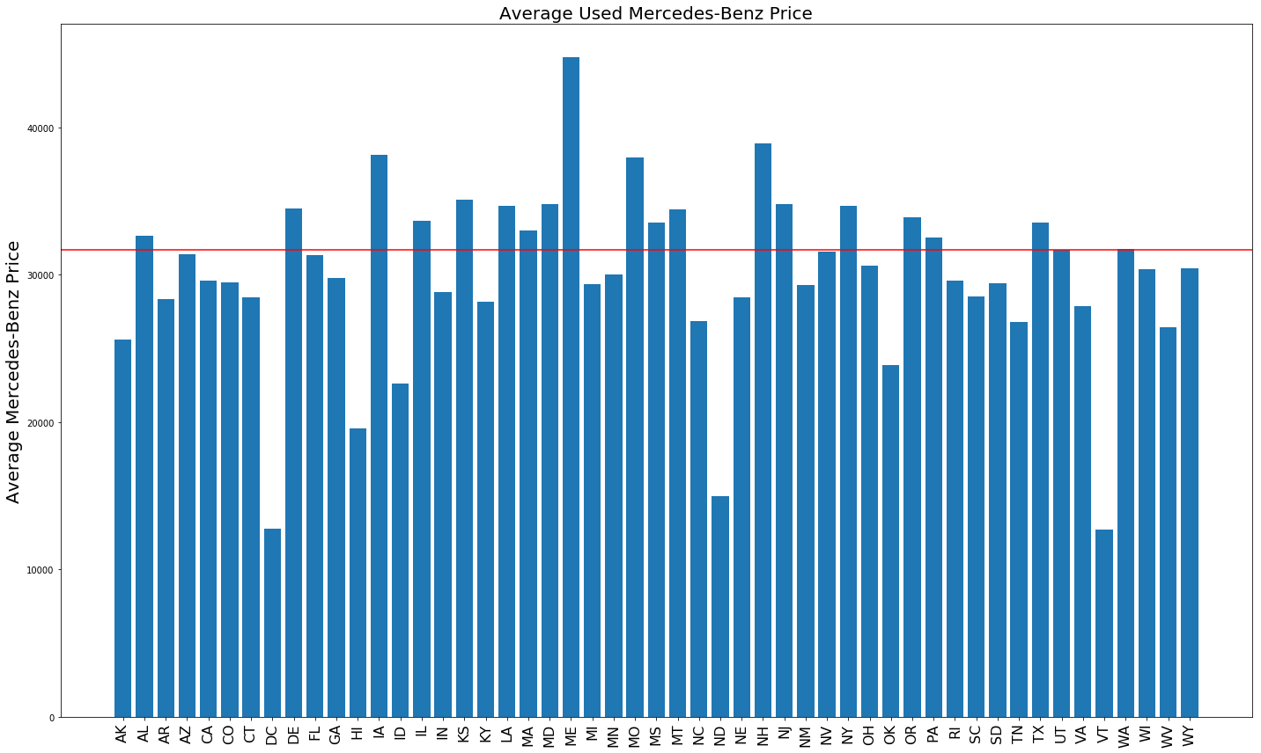
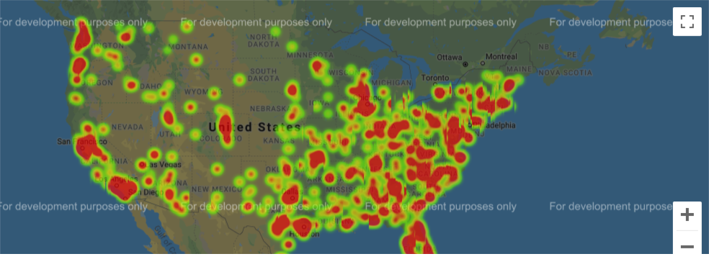
Mercedes-Benz Used Car Sales Price
Notes:
Mercedes average sales price - $31696.05

Slide 14
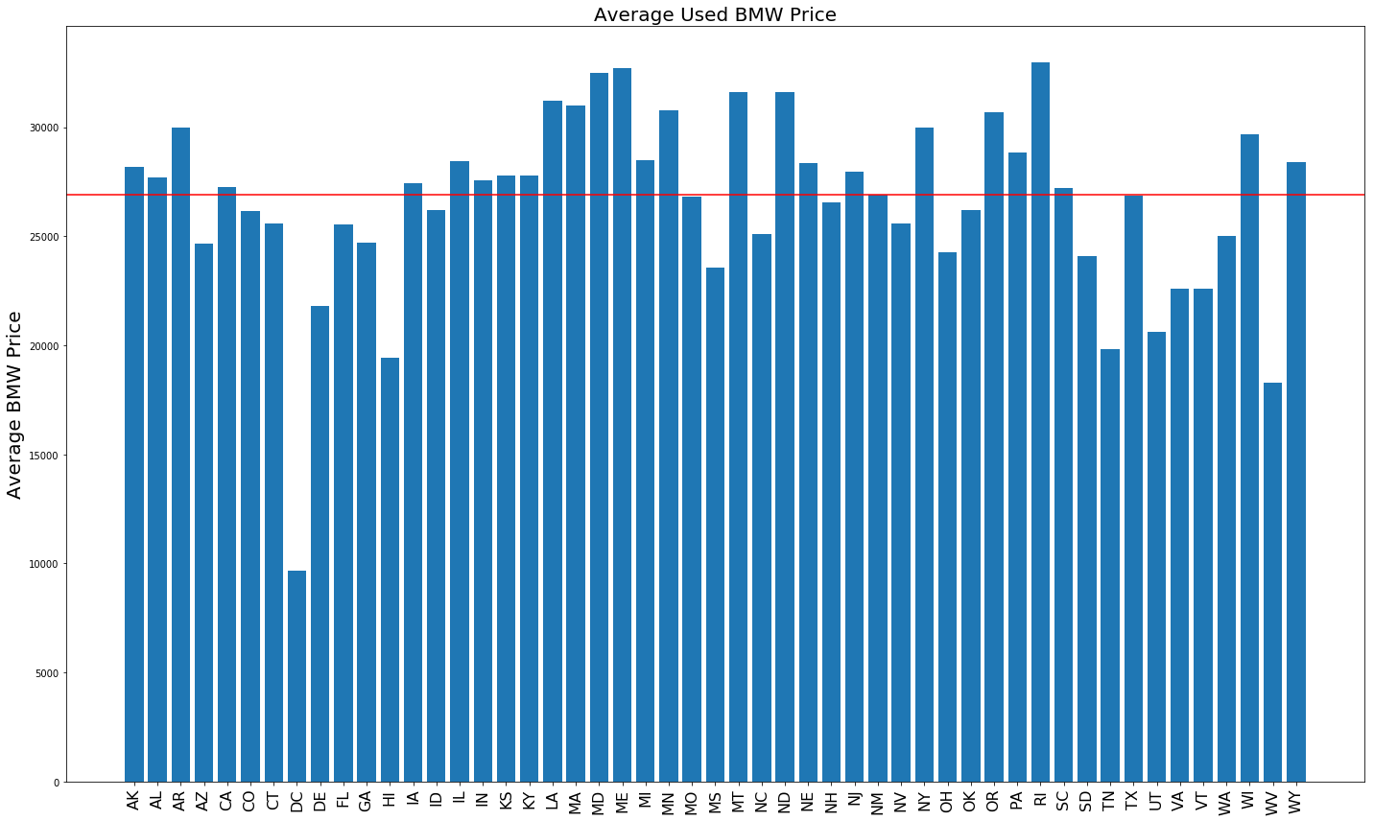
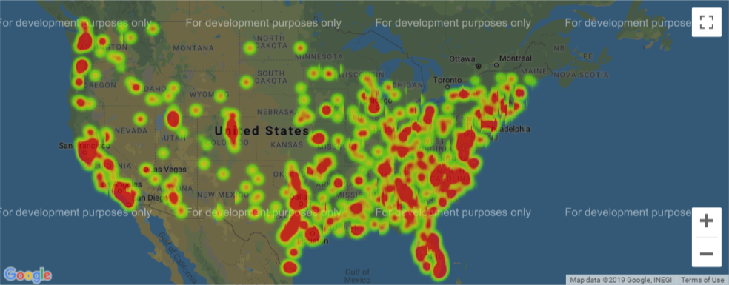
BMW Used Car Sales Price
Notes:
BMW average sales price - $26920.71

Slide 15
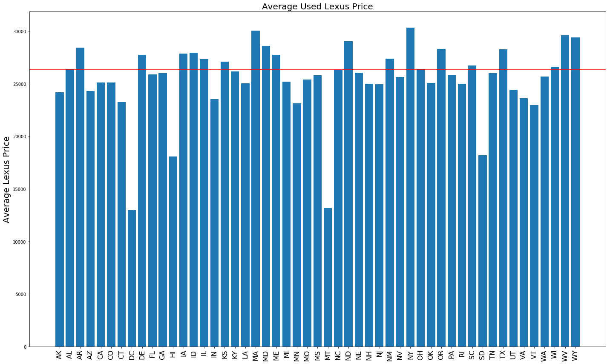
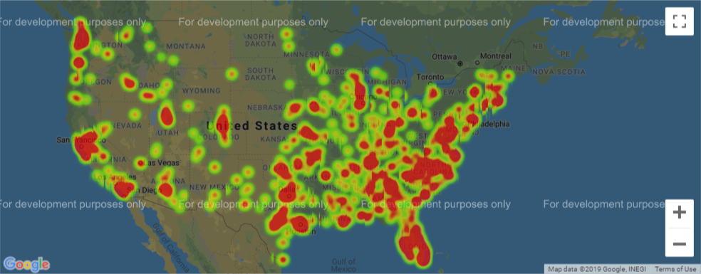
Lexus Used Car Sales
Notes:
Lexus average sales price - $26367.21

Slide 16
What are the top 3 car Makes sold?
Number of car sales – 1,216,250
Top 3 Car Makes
Ford – 13.32 %
Chevrolet – 12.37%
Toyota – 9.46%

Slide 17
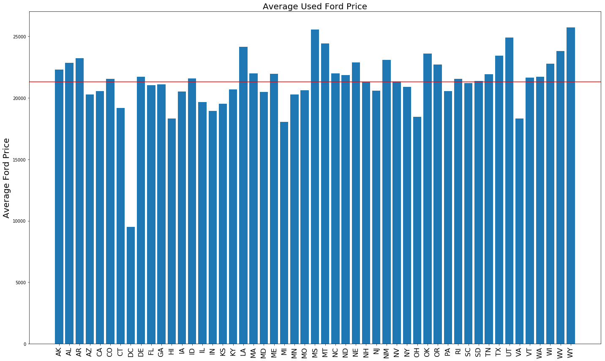
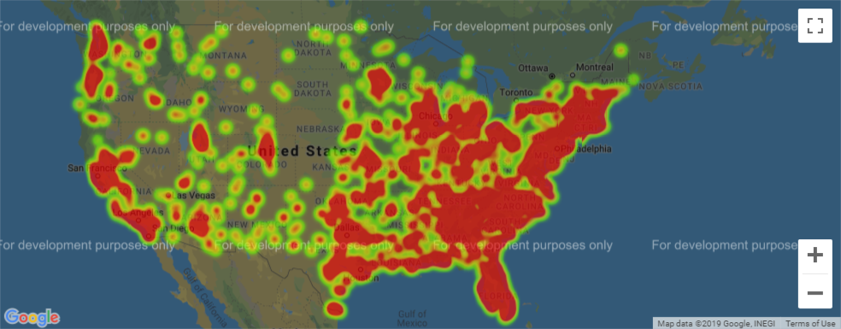
Ford Used Car Sales Price
Notes:
Ford average sales price - $21311.80

Slide 18
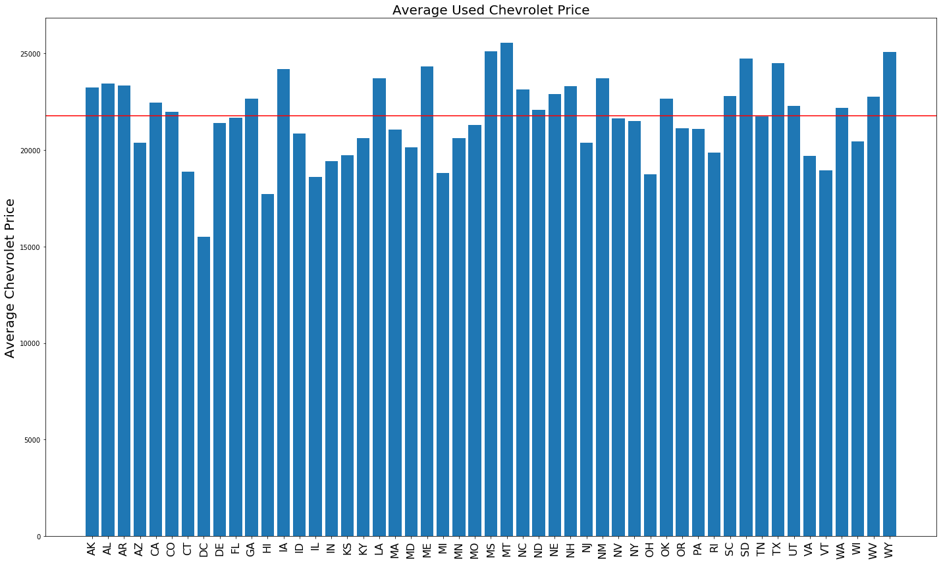

Chevrolet Used Sales Price
Notes:
Chevrolet Average Sales price - $21770.09

Slide 19
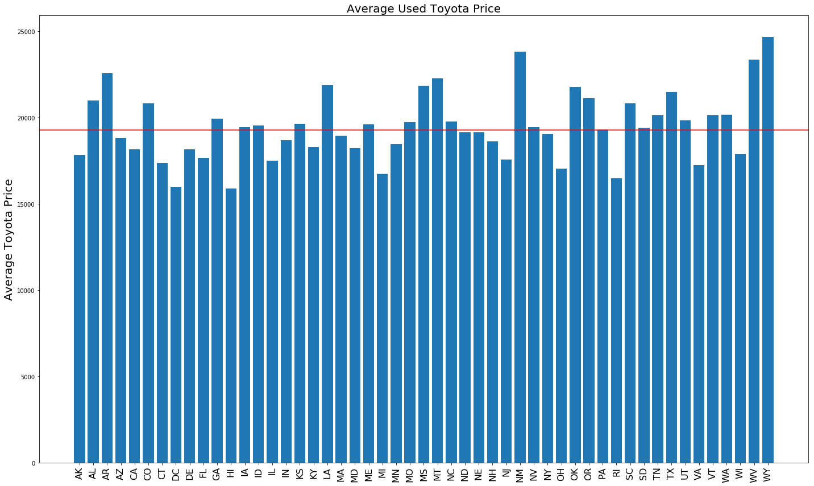
Toyota Used Sales Price
Notes:
Toyota Average Sales price - $19275.61

Slide 20
Which cars are the Top Luxury and Non-Luxury Car Models
Mercedes-Benz
Ford
E-Class E350
C-Class C300
M-Class ML350
GLK-Class GLK350
C-Class C
F-150 4WD
Fusion SE
Super
F-150 XLT
Explorer XLT

Slide 21
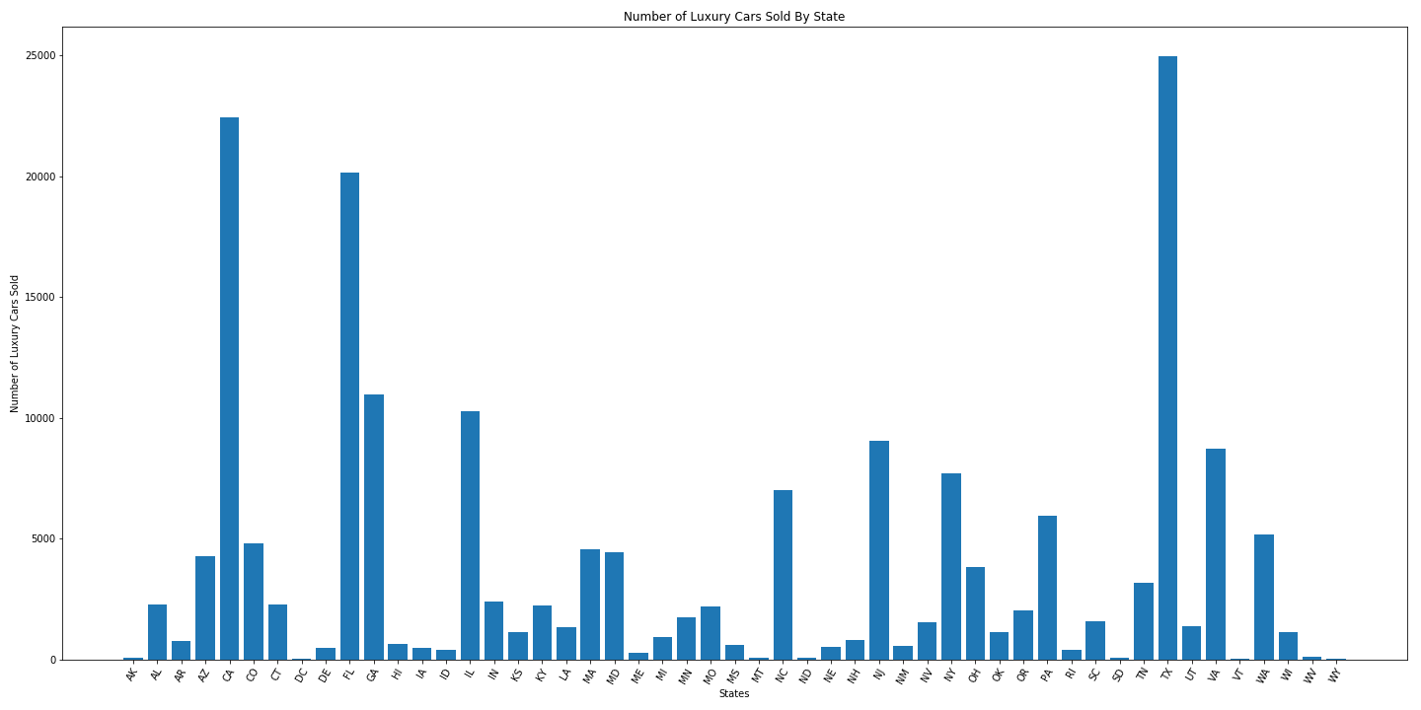
What state has the most & least luxury car sales? # of Luxury Car sales per state

Slide 22
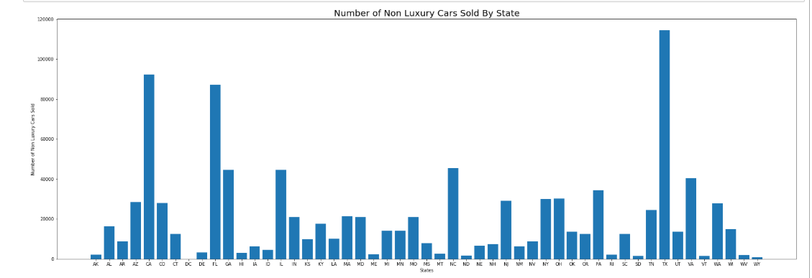
What state has the most non-Luxury car sales? # of Non-Luxury Car sales per state

Slide 23
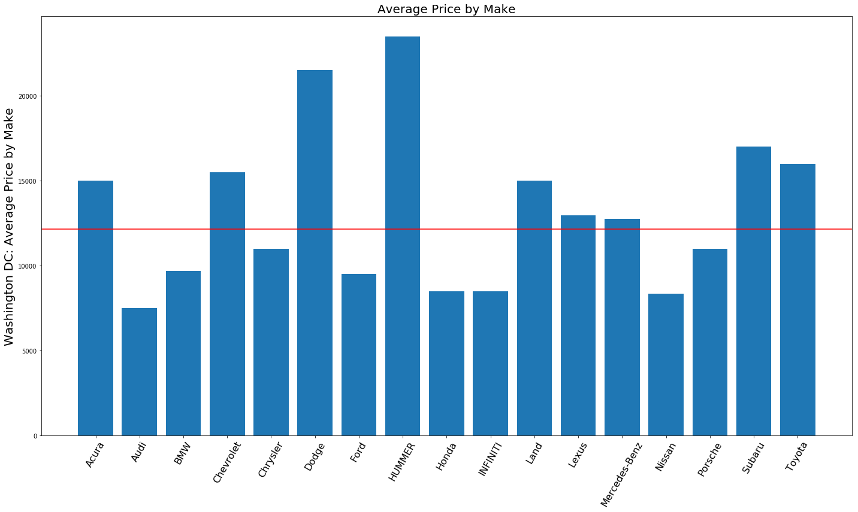
Is it cheaper to purchase a car in DC? DC Used Car Sales
Notes:
# of cars listed in DC

Slide 24
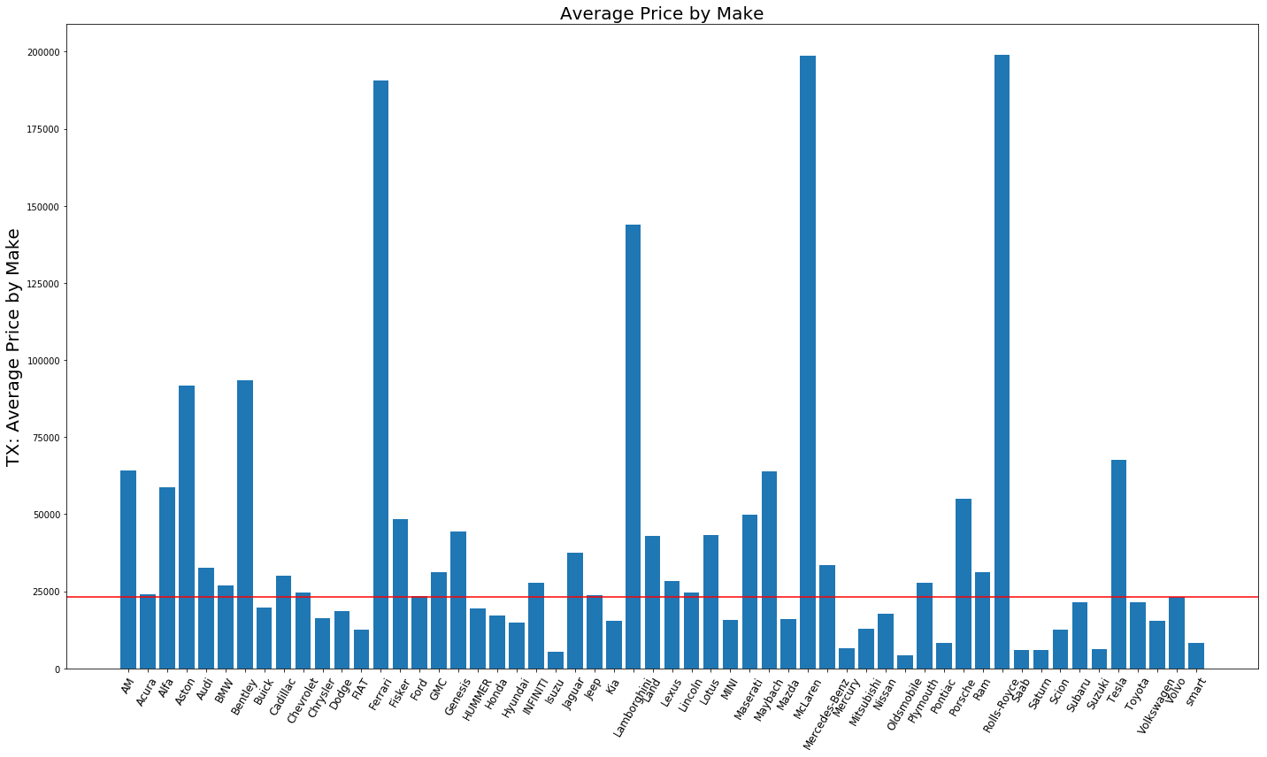
Texas Used Car Sales
Notes:
Average sales price in Texas - $23081.81

Slide 25
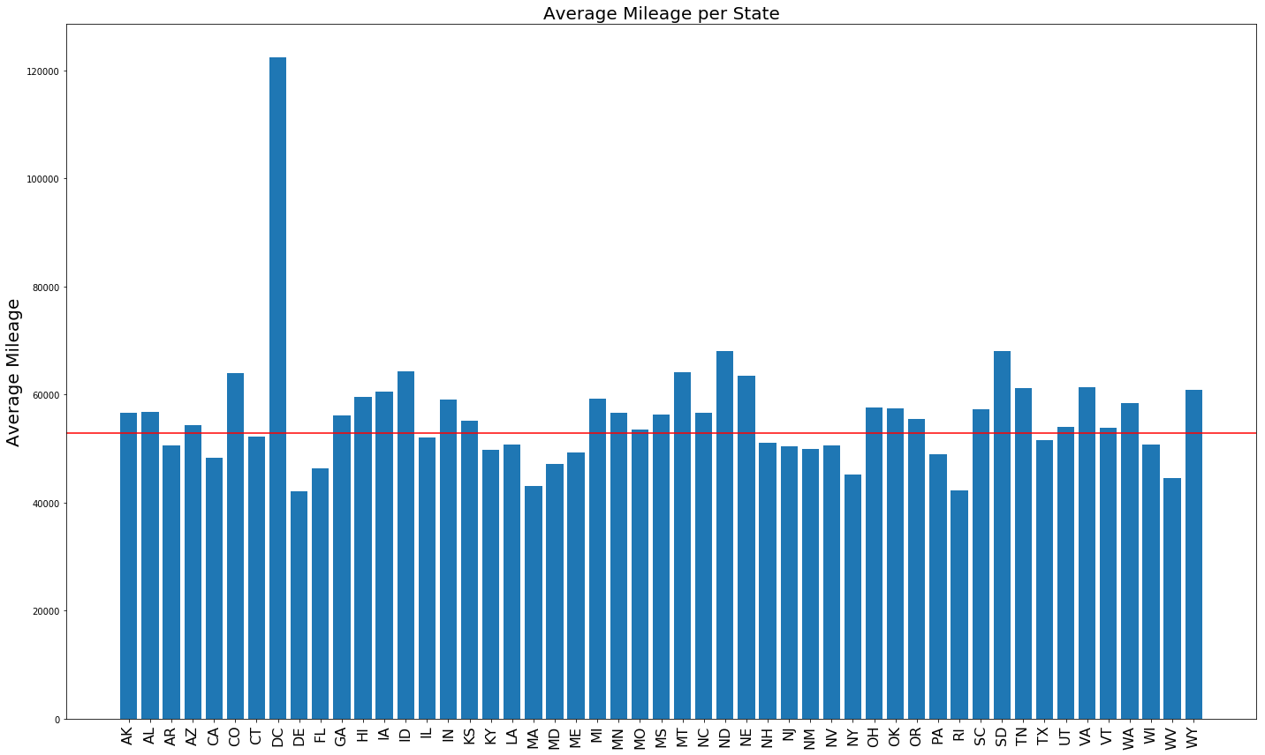
Average Mileage per State
Lowest Miles
DE: 42,107
RI: 42,336
MA: 43,152
WV: 44,550
NY: 45,152
Highest Miles
DC: 122,420
SD: 68,072
ND: 68,012
ID: 64,364
MT: 64,077
Notes:
Lowest

Slide 26
What are the top car models listed?
Silverado – 36,174
Grand – 25,418
Altima 2.5 – 16,824
Sierra – 16,471
Accord – 14,946

Slide 27
Conclusion
We recommend to research wisely when purchasing a car
Know how many of a particular car is sold in other similar city types in order to get the best deal
Cars appear cheaper in DC as there are not many cars sold in DC and the miles are higher
Even though metropolitan cities have the most variety of public transportation, cars are most expensive there.
We believe you might get a better deal in a particular state where there are more car sales for your desired car therefore we recommend purchasing luxury and non-luxury cars in:
Texas
California
Florida
The cars in these states have lower miles than the average
Remember to not purchase in the metropolitan area of these States.
A used luxury car will cost you between $23k-215k with a average price $30,172 with an average mileage of 49,894
A used non luxury has an average prices of $19,274 with an average mileage 53,463
Lastly, we recommend staying away from South Dakota and Montana as their cars have higher miles and higher than average cost. Purchase cars from Delaware and Massachusetts as cars in these states have lower miles and about average cost.

Slide 28
Issues Encountered
Data doesn’t include date of purchase so we were limited in trending data over a specified time
Data set did not include vehicle type in order to know the type of car people are driving in certain areas across the country
Relating median household income to areas where car prices are higher

